Slide 1
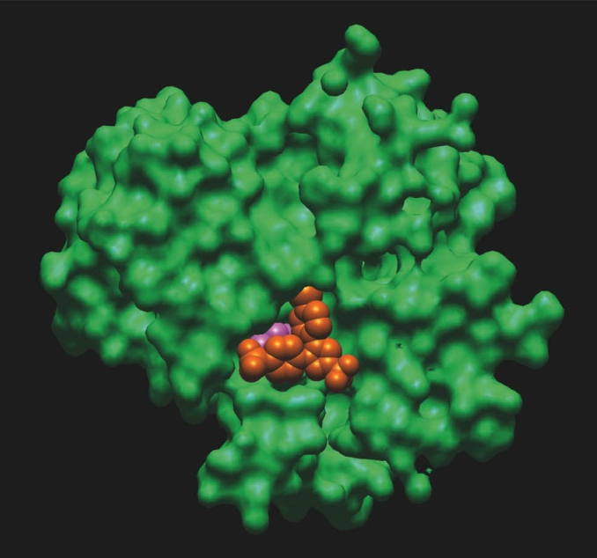
Energy, Enzymes, and Metabolism

Slide 2
Energy, Enzymes, and Metabolism
Energy and Energy Conversions
ATP: Transferring Energy in Cells
Enzymes: Biological Catalysts
Molecular Structure Determines Enzyme Function
Metabolism and the Regulation of Enzymes

Slide 3
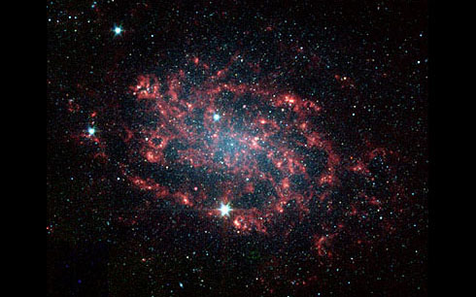
Chapter 6 in Summary – Part 1
The universe wants our rooms to be messy… and us not around!
Image source: http://science.hq.nasa.gov/universe/images/ngc300.jpg

Slide 4
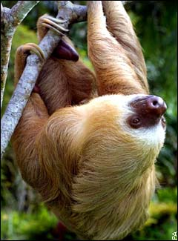
Chapter 6 in Summary – Part 2
Without enzymes…
we would probably be hanging from trees.
Image source: http://students.washington.edu/segraham/tree%20sloth.jpg

Slide 5
The Basics of Energy
Energy represents the capacity to do work or to change things (e.g., chemical bonds).
There are two basic types of energy: kinetic energy and potential energy.
Energy is neither created nor destroyed, but energy can be transformed,… but not at 100% efficiency (e.g., from light energy to electrical energy to chemical energy).
Life must acquire energy from the environment to maintain their structure and function.

Slide 6
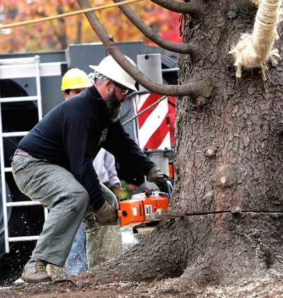
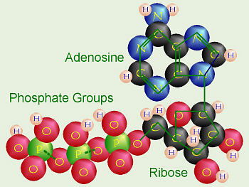
The Basics of Energy
Energy represents the capacity to do work or to change things (e.g., chemical bonds).
ATP
http://biology.clc.uc.edu/graphics/bio104/atp.jpg
http://www.nynewsday.com/media/photo/2005-11/20405580.jpg

Slide 7
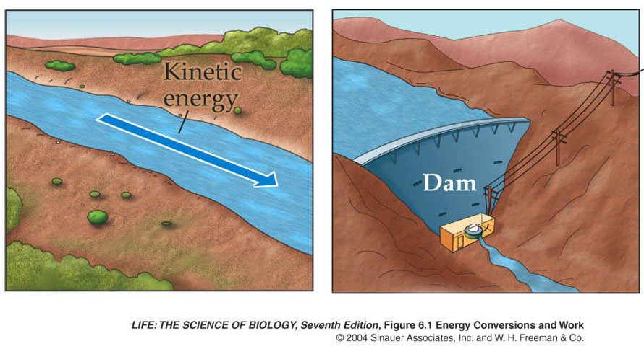
The Basics of Energy
There are two basic types of energy: kinetic energy and potential energy.
Sugar anyone?

Slide 8
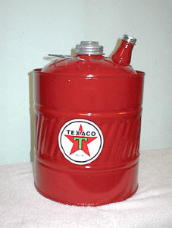
Energy and Energy Conversions
Potential energy is energy of state or position—it is stored energy.
Kinetic energy is the energy of movement. Kinetic energy does work that alters the state or motion of matter.
http://www.bobs-garage.com/oil/gascan.gif
www.iacph.kiae.ru

Slide 9
The Basics of Energy
Energy is neither created nor destroyed, but energy can be transformed,… but not at 100% efficiency.

Slide 10
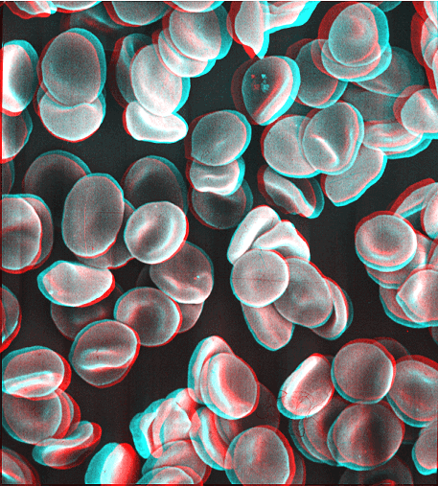
Energy and Energy Conversions
The first law of thermodynamics states that: During any conversion of forms of energy, the total initial energy will equal the total final energy. Energy is neither created nor destroyed.
Living cells obey this law.
http://www.udel.edu/Biology/Wags/wagart/anaglyphpage/red%20cells%20.gif

Slide 11
Basics of Energy

Slide 12
Energy and Energy Conversions
Second law of thermodynamics: When energy is transformed, some becomes unavailable to do work.
No physical process or chemical reaction is 100 per cent efficient, that is, not all the energy released can be used to do work.

Slide 13
Figure 6.1 Energy Conversions and Work

Slide 14
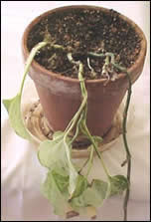
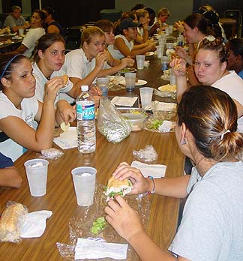
The Basics of Energy
Life must acquire energy from the environment to maintain their structure and function.
http://www.moversdirectory.com/images/dead_plant.jpg
http://www.fsu.edu/~activity/womensrugby/camp_photos02/lunch.jpg

Slide 15
Energy and Energy Conversions
In living organisms, the topic of energy generally focuses on METABOLISM.
“Metabolism: The sum total of the chemical reactions that occur in an organism, or some subset of that total (as in respiratory metabolism).”
“In all cells of all organisms, two types of metabolic reactions occur:”
Anabolic Reactions & Catabolic Reactions
Source: Purves et al. modified font size and style

Slide 16
Energy and Energy Conversions
METABOLIC REACTIONS:
Anabolic reactions link simple molecules together to make complex ones. These are energy-storing reactions.
Catabolic reactions break down complex molecules into simpler ones. Some of these reactions provide the energy for anabolic reactions.
?
http://chsweb.lr.k12.nj.us/mstanley/outlines/respiration/image150.gif

Slide 17
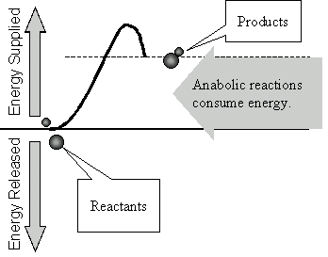
Anabolic Reaction
http://faculty.clintoncc.suny.edu/faculty/Michael.Gregory/files/Bio%20101/Bio%20101%20Lectures/energy/Image6.gif

Slide 18
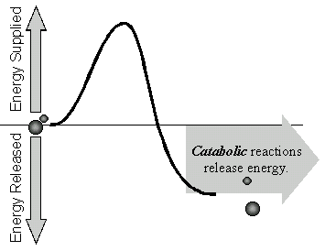
Catabolic Reaction
http://faculty.clintoncc.suny.edu/faculty/Michael.Gregory/files/Bio%20101/Bio%20101%20Lectures/energy/Image8.gif

Slide 19
Energy and Energy Conversions
In any system:
total energy = usable energy + unusable energy
Or:
enthalpy (H) = free energy (G) + entropy (S)
H = G + TS (T = absolute temperature)
Entropy is a measure of the disorder of a system.
Usable energy (free energy):
G = H – TS

Slide 20
Energy and Energy Conversions
G, H, and S cannot be measured precisely.
Change in each at a constant temperature can be measured precisely in calories or joules.
ΔG = ΔH – TΔS
If ΔG is positive (+), free energy is required. This is the case for anabolic reactions.
ENDERGONIC REACTIONS
If ΔG is negative (–), free energy is released. This is the case for catabolic reactions.
EXERGONIC REACTIONS

Slide 21
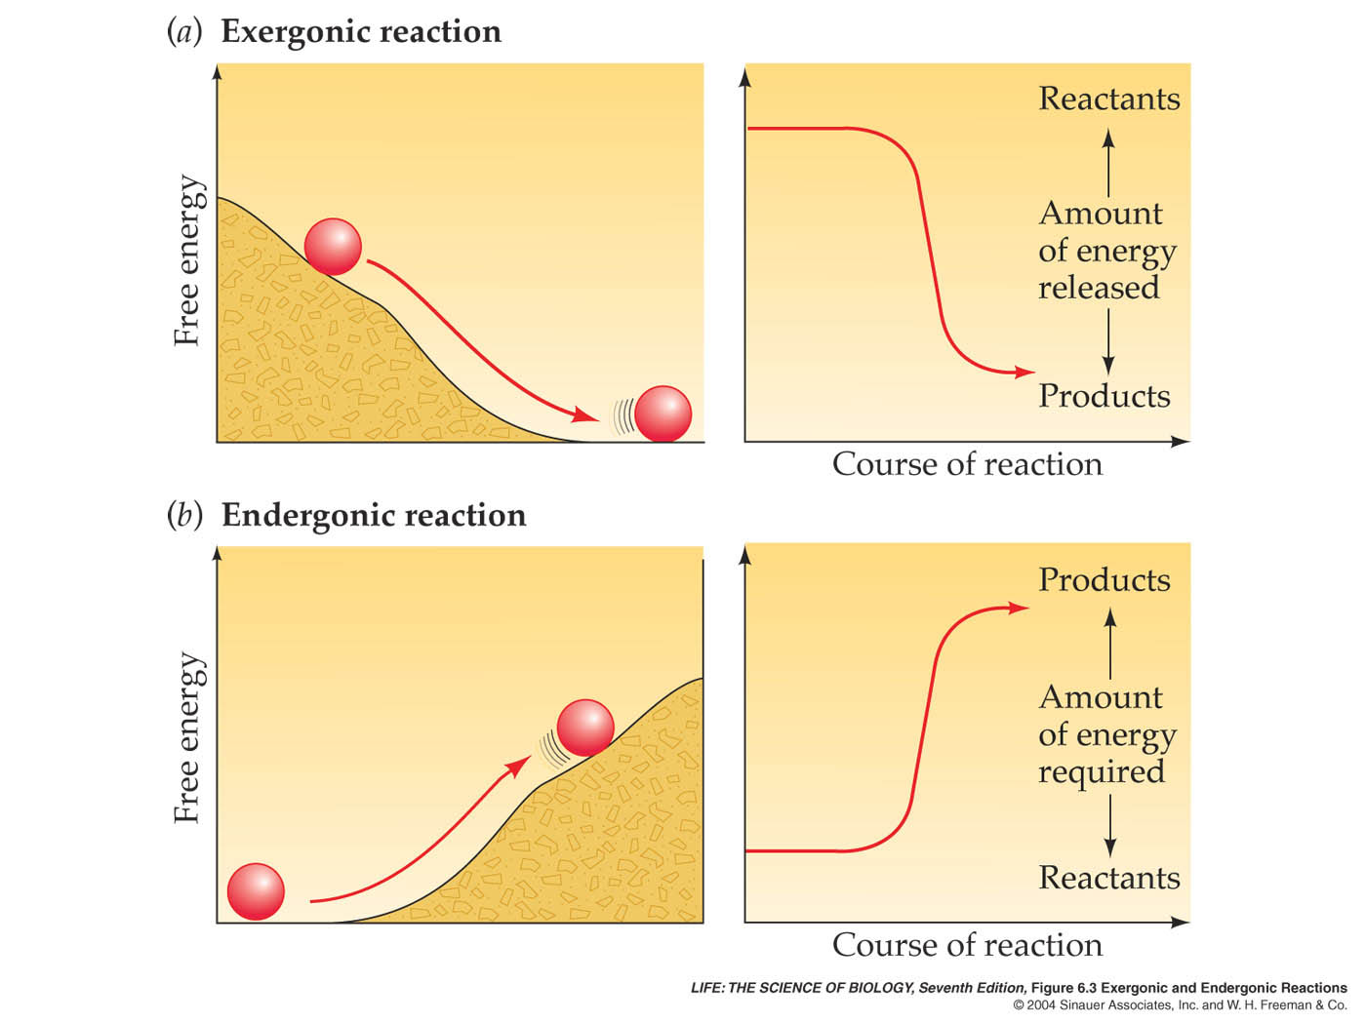
Figure 6.3 Exergonic and Endergonic Reactions

Slide 22
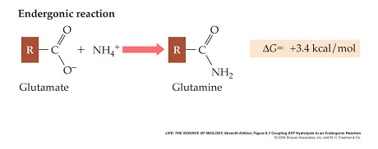
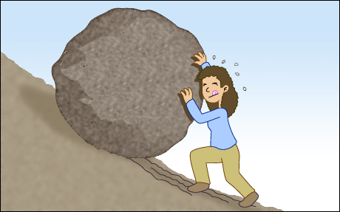
An Endergonic Reaction
www.educationworld.com/a_issues/school_doodles/images/schooldoodlelarge49.gif (modified)

Slide 23
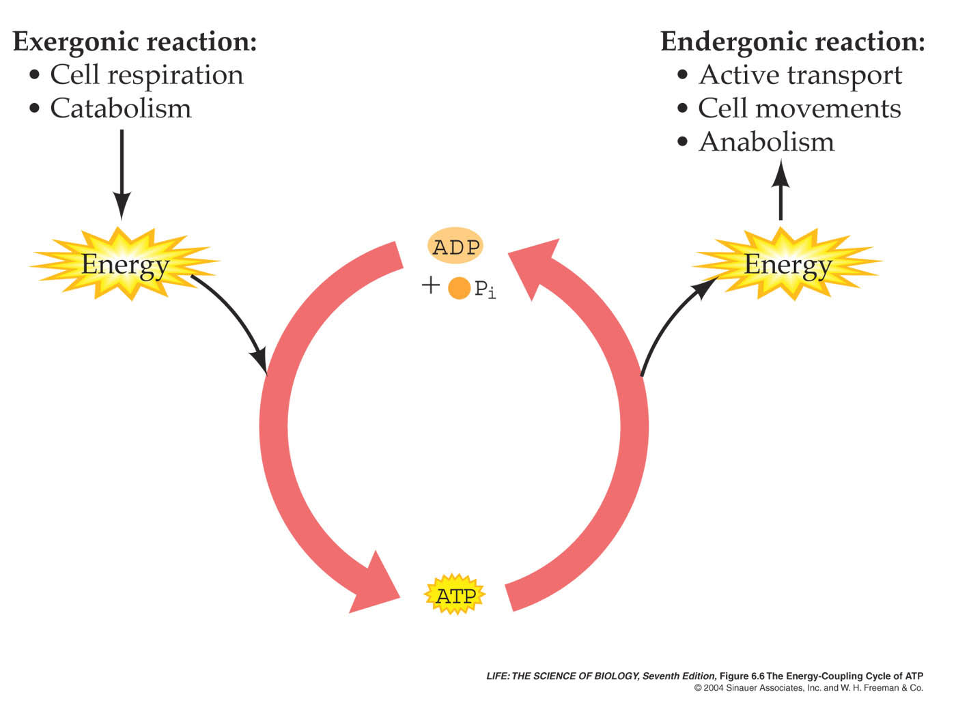
Figure 6.6 The Energy-Coupling Cycle of ATP

Slide 24
ATP: Transferring Energy in Cells
ATP can hydrolyze to yield ADP and an inorganic phosphate ion (P_{i}).
ATP + H₂O → ADP + P_{i} + free energy
The reaction is exergonic (ΔG = –12 kcal/mol).
Free energy of the P–O bond is much higher than the H–O bond that forms after hydrolysis.
Phosphates are negatively charged, so energy is required to get them near each other to bond (to add a phosphate to ADP).

Slide 25
ATP: Transferring Energy in Cells
The formation of ATP from ADP and P_{i}, is endergonic and consumes as much free energy as is released by the breakdown of ATP:
ADP + P_{i} + free energy → ATP + H₂O
ATP shuttles energy from exergonic reactions to endergonic reactions.
Each cell requires millions of molecules of ATP per second to drive its biochemical machinery.
Each ATP molecule undergoes about 10,000 cycles of synthesis and hydrolysis every day.

Slide 26
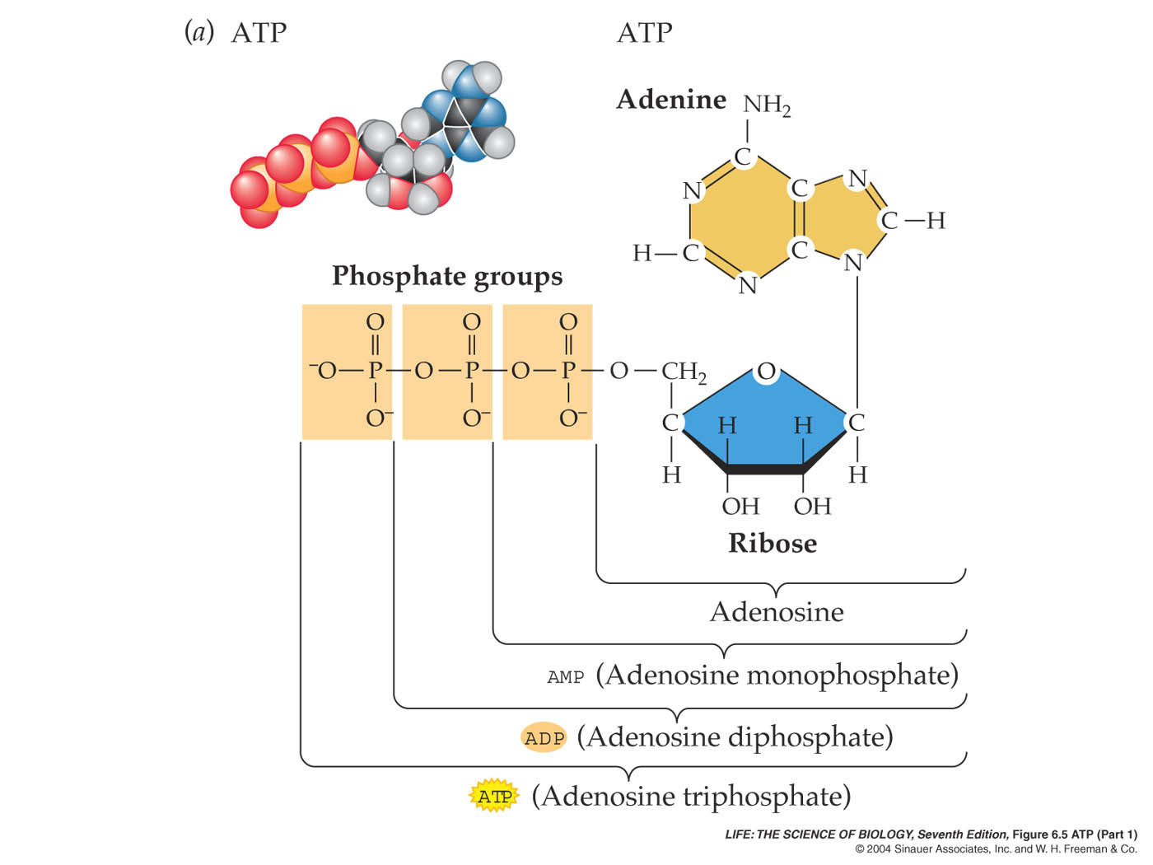
Figure 6.5 ATP (Part 1)

Slide 27
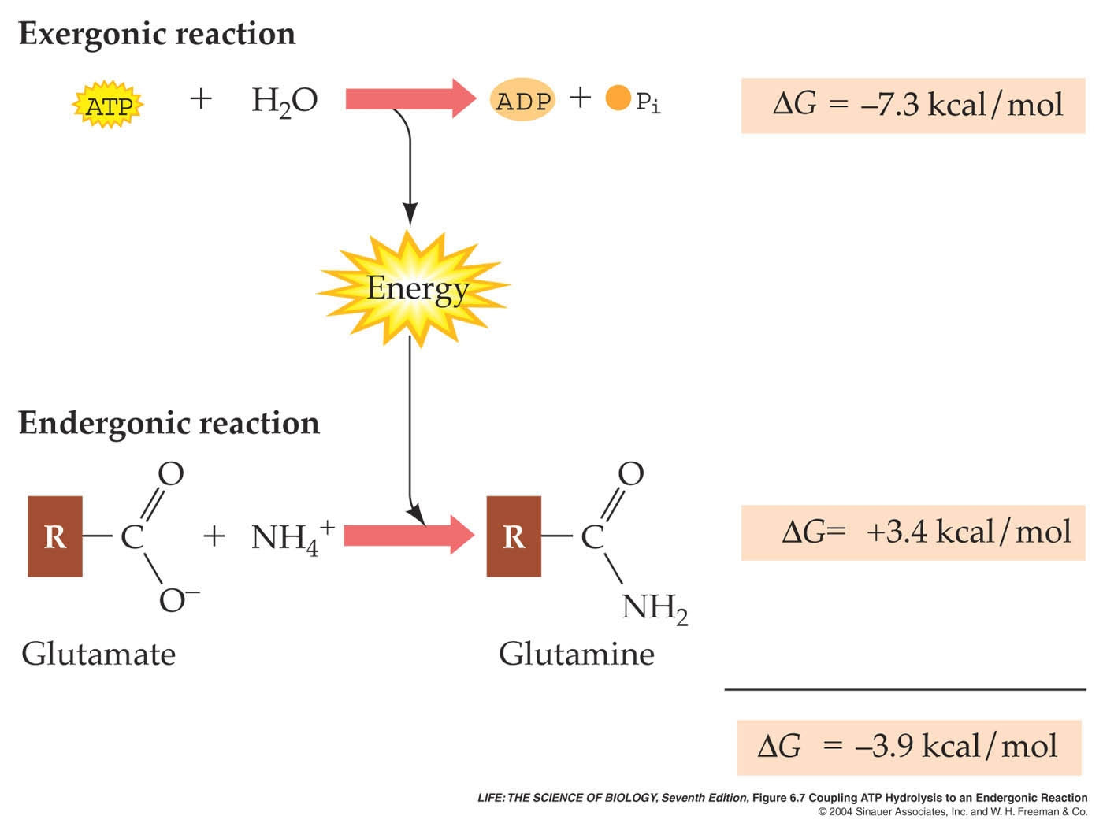
Figure 6.7 Coupling ATP Hydrolysis to an Endergonic Reaction

Slide 28
Another Example

Slide 29
Energy, Enzymes, and Metabolism
Energy and Energy Conversions
ATP: Transferring Energy in Cells
Enzymes: Biological Catalysts
Molecular Structure Determines Enzyme Function
Metabolism and the Regulation of Enzymes

Slide 30
Life is Too Slow without Catalysts
Image source: http://students.washington.edu/segraham/tree%20sloth.jpg

Slide 31
Enzymes: Biological Catalysts
A catalyst is any substance that speeds up a chemical reaction without itself being used up.
Living cells use biological catalysts to increase rates of chemical reactions.
Most biological catalysts are proteins called enzymes. Certain RNA molecules called ribozymes are also catalysts.

Slide 32
Enzymes: Biological Catalysts
The direction of a reaction can be predicted if ΔG is known, but not the rate of the reaction.
Some reactions are slow because there is an energy barrier between reactants and products.
Exergonic reactions proceed only after the addition of a small amount of added energy, called the activation energy (E_{a}).
In a chemical reaction, activation energy is the energy needed to put molecules into a transition state.
Transition-state species have higher free energy than either reactants or products.

Slide 33
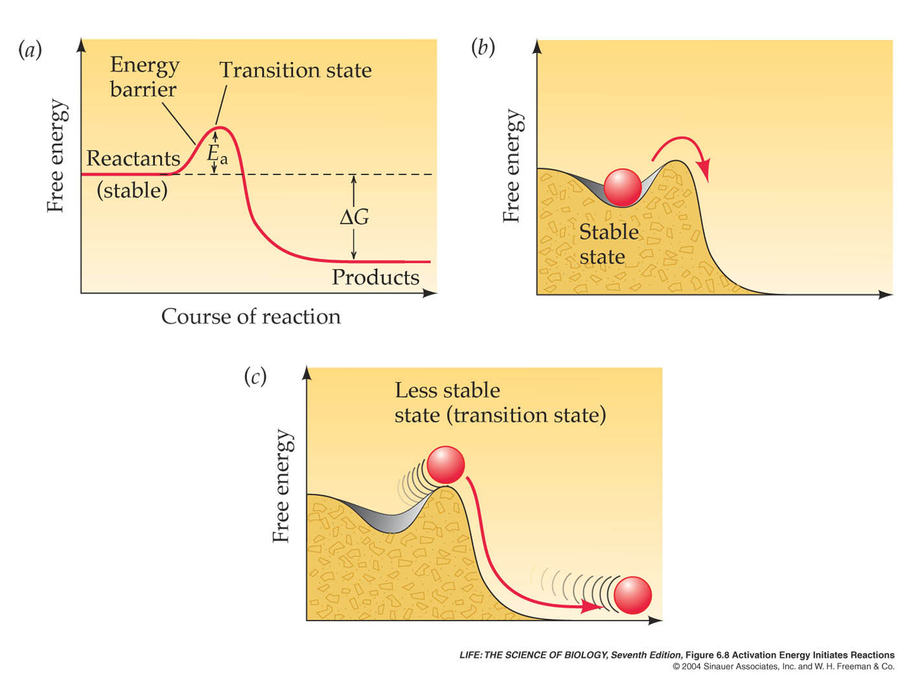
Figure 6.8 Activation Energy Initiates Reactions

Slide 34
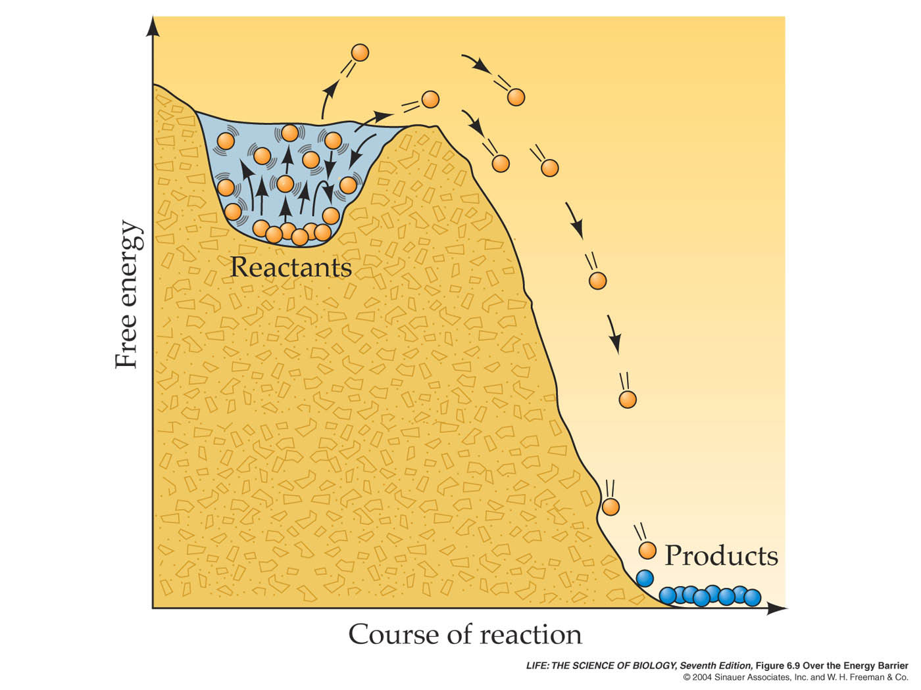
Figure 6.9 Over the Energy Barrier

Slide 35
Enzymes: Biological Catalysts
Enzymes bind specific reactant molecules called substrates.
Substrates bind to a particular site on the enzyme surface called the active site, where catalysis takes place.
Enzymes are highly specific: They bind specific substrates and catalyze particular reactions under certain conditions.
The specificity of an enzyme results from the exact three-dimensional shape and structure of the active site.

Slide 36
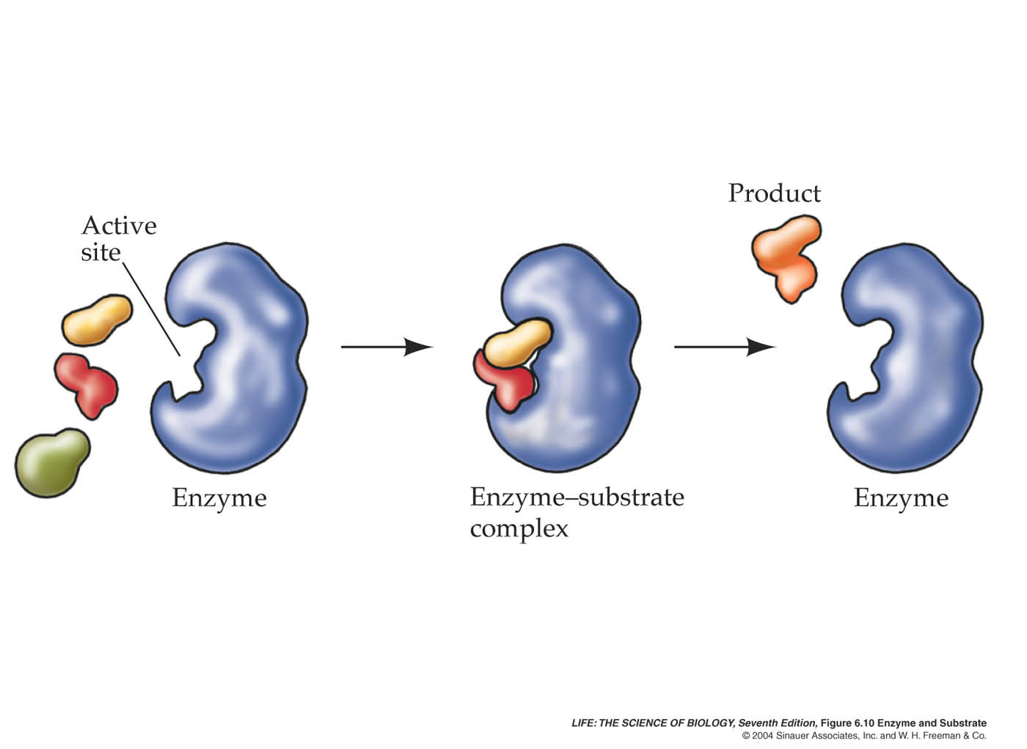
Figure 6.10 Enzyme and Substrate

Slide 37
Enzymes: Biological Catalysts
The names of enzymes reflect their function:
RNA polymerase catalyzes formation of RNA but not DNA.
RNA nuclease hydrolyzes RNA polymers.
Hexokinase accelerates phosphorylation of hexose.
All kinases add phosphates. All phosphatases remove phosphates.

Slide 38
Enzymes: Biological Catalysts
Binding a substrate to the active site produces an enzyme–substrate complex (ES).
Hydrogen bonding, ionic attraction, or covalent bonding acting individually or together hold these complexes together.
The enzyme–substrate complex (ES) generates the product (P) and free enzyme (E):
E + S → ES → E + P

Slide 39
Enzymes: Biological Catalysts
Enzymes lower activation energy requirements and thus speed up the overall reaction, but they do not change the difference in free energy (ΔG) between the reactants and the products.
Thus they do not affect the final equilibrium.
Enzymes can have a profound effect on reaction rates. Reactions that might take years to happen can occur in a fraction of a second.

Slide 40
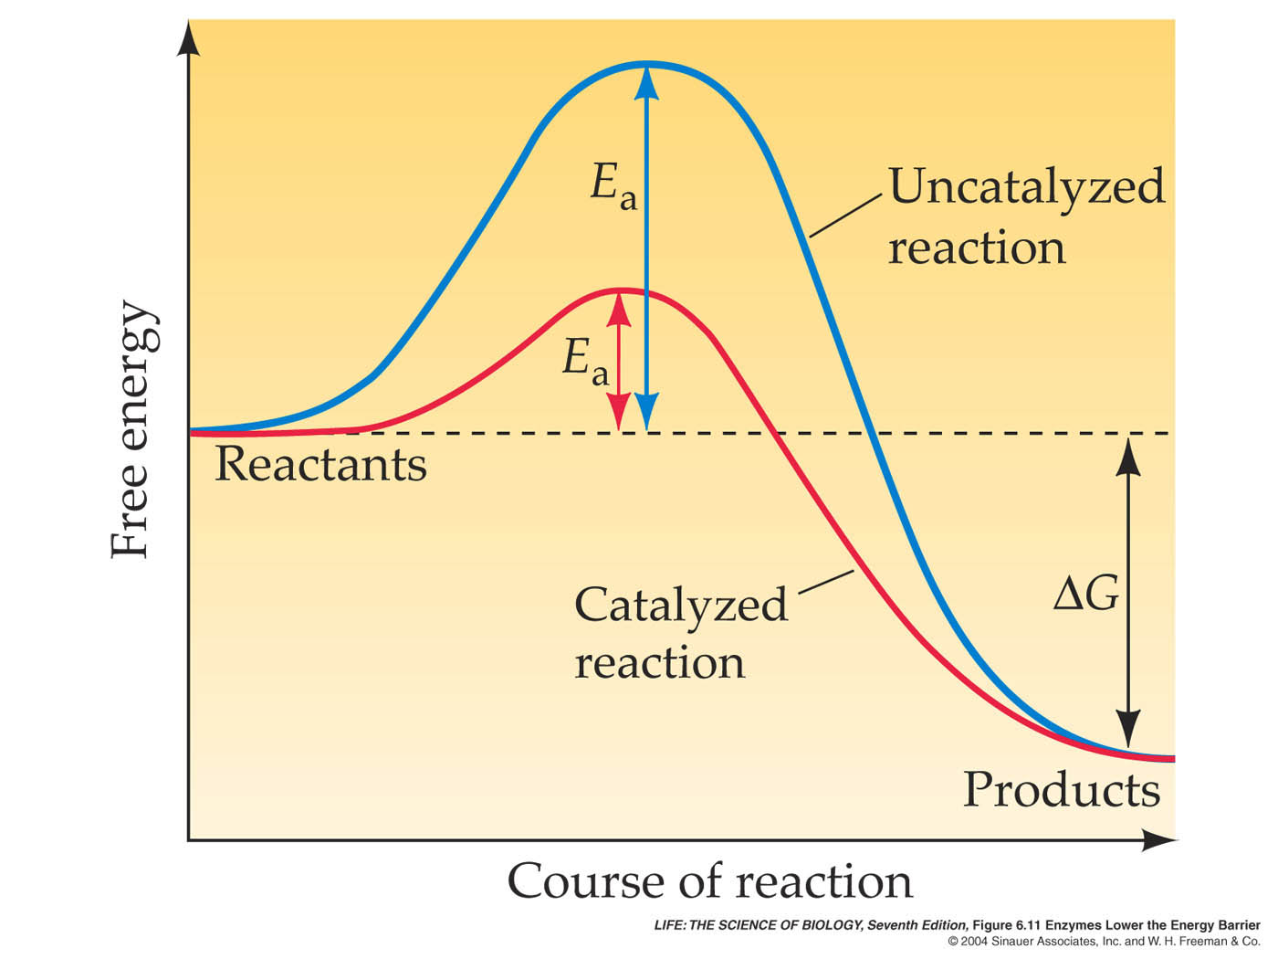
Figure 6.11 Enzymes Lower the Energy Barrier

Slide 41
Enzymes: Biological Catalysts
At the active sites, enzymes and substrates interact by breaking old bonds and forming new ones.
Enzymes catalyze reactions using one or more of the following mechanisms:
Orienting substrates
Inducing strain in the substrates
Adding charges to substrates

Slide 42
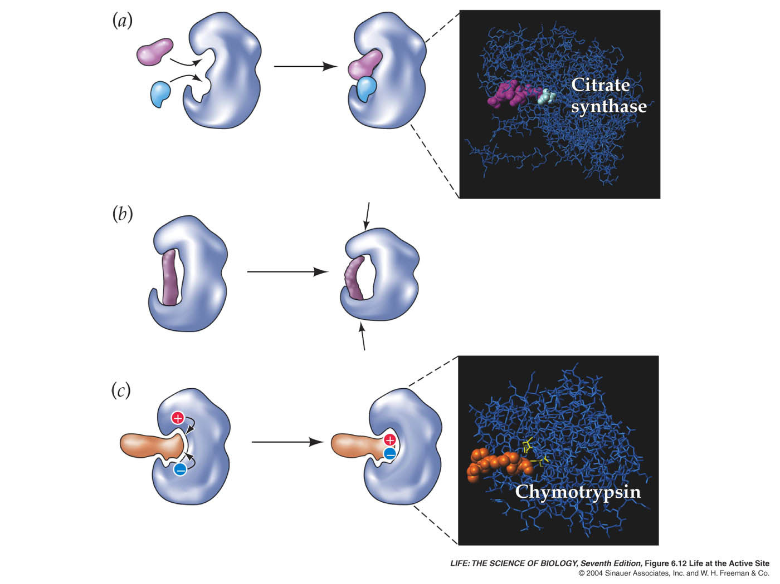
Figure 6.12 Life at the Active Site

Slide 43
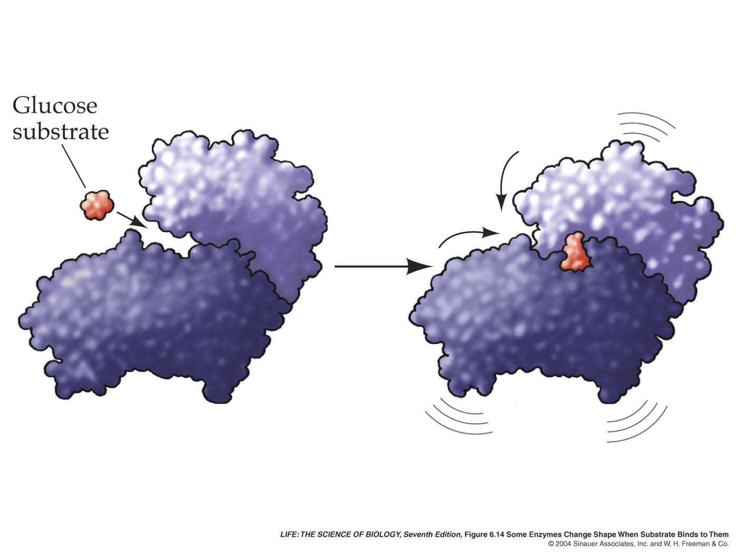
Figure 6.14 Some Enzymes Change Shape When Substrate Binds to Them

Slide 44
Molecular Structure Determines Enzyme Function
Some enzymes require other molecules in order to function:
Cofactors are metal ions (e.g., copper, zinc, iron) that bind temporarily to certain enzymes and are essential to their function.
Coenzymes are small molecules that act like substrates. They bind to the active site and change chemically during the reaction, then separate to participate in other reactions.
Prosthetic groups are permanently bound to enzymes. They include the heme groups that are attached to hemoglobin.

Slide 45
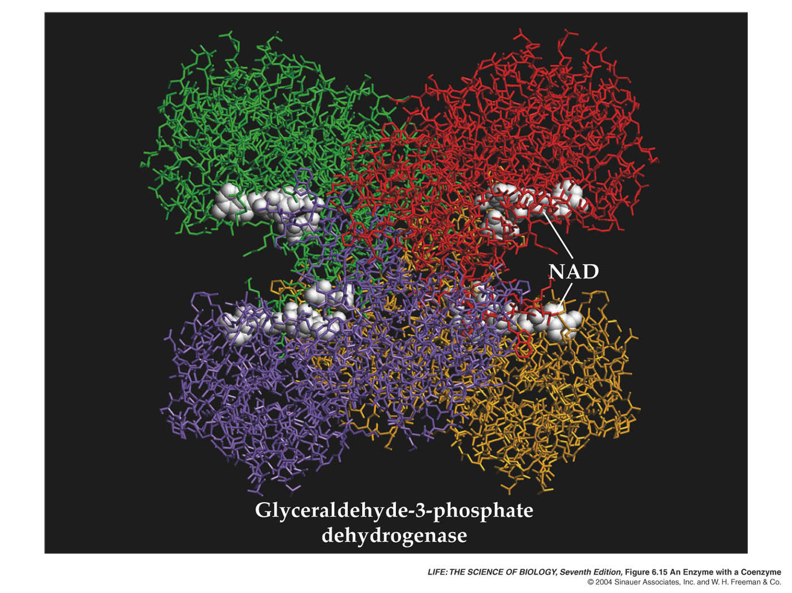
Figure 6.15 An Enzyme with a Coenzyme

Slide 46
Molecular Structure Determines Enzyme Function
The rate of an uncatalyzed reaction is directly proportional to the concentration of reactants.
This is true up to a point with catalyzed reactions, but then the rate levels off.
This is due to saturation of the enzyme, when all the enzyme molecules are bound to substrate.
Turnover number is the number of substrate molecules converted to product per unit time.
The turnover number ranges from 1 molecule every 2 seconds for lysozyme, to 40 million per second for the liver enzyme catalase.

Slide 47
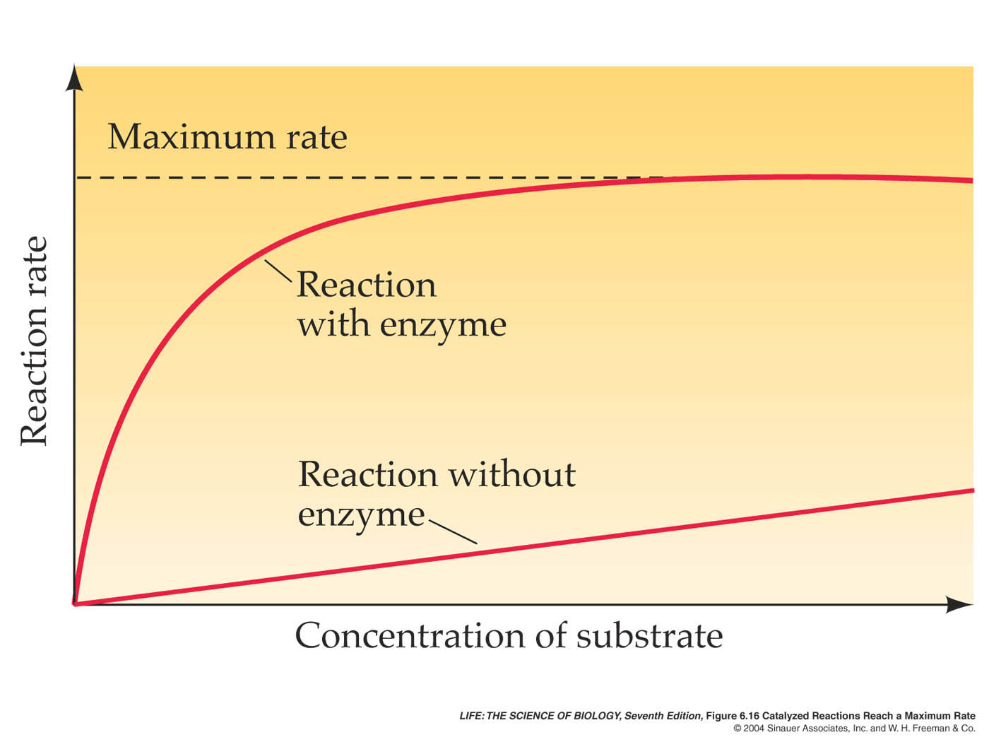
Figure 6.16 Catalyzed Reactions Reach a Maximum Rate

Slide 48
Metabolism and the Regulation of Enzymes
An organism’s metabolism is the total of all biochemical reactions taking place within it.
Metabolism is organized into sequences of enzyme-catalyzed chemical reactions called metabolic pathways.
In these sequences, the product of one reaction is the substrate for the next.
A B C D
enzyme
enzyme
enzyme

Slide 49
Metabolism and the Regulation of Enzymes
Some metabolic pathways are anabolic and synthesize the building blocks of macromolecules.
Some are catabolic and break down macro-molecules and fuel molecules.
The balance among these pathways can change depending on the cell’s needs, so a cell must regulate its metabolic pathways constantly.

Slide 50
Metabolism and the Regulation of Enzymes
Animation 6.1 – Enzyme Catalysis
Four animations – one at a time.

Slide 51
Metabolism and the Regulation of Enzymes
Not all inhibition is irreversible.
When an inhibitor binds reversibly to an enzyme’s active site, it competes with the substrate for the binding site and is called a competitive inhibitor.
When the concentration of the competitive inhibitor is reduced, it no longer binds to the active site, and the enzyme can function again.

Slide 52
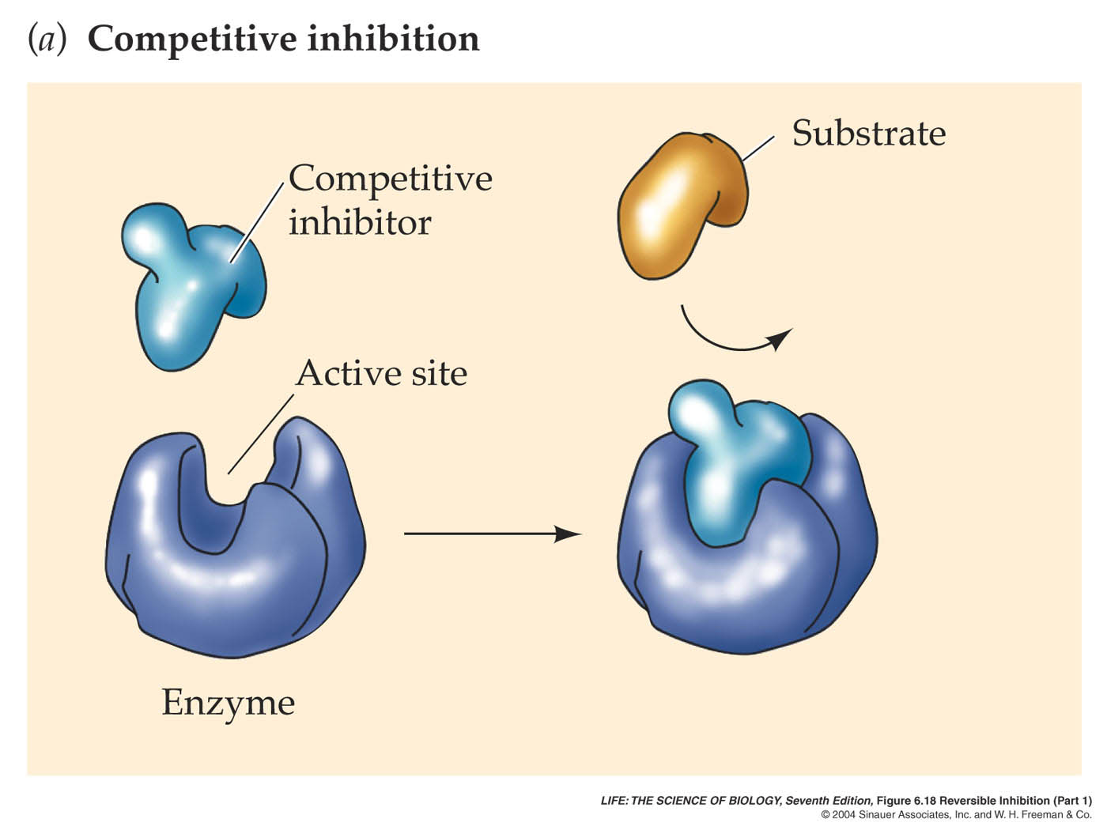
Figure 6.18 (a) Reversible Inhibition (Part 1)

Slide 53
Metabolism and the Regulation of Enzymes
When an inhibitor binds reversibly to a site distinct from the active site, it is called a noncompetitive inhibitor.
Noncompetitive inhibitors act by changing the shape of the enzyme in such a way that the active site no longer binds the substrate.
Noncompetitive inhibitors can unbind from the enzyme, making the effects reversible.

Slide 54
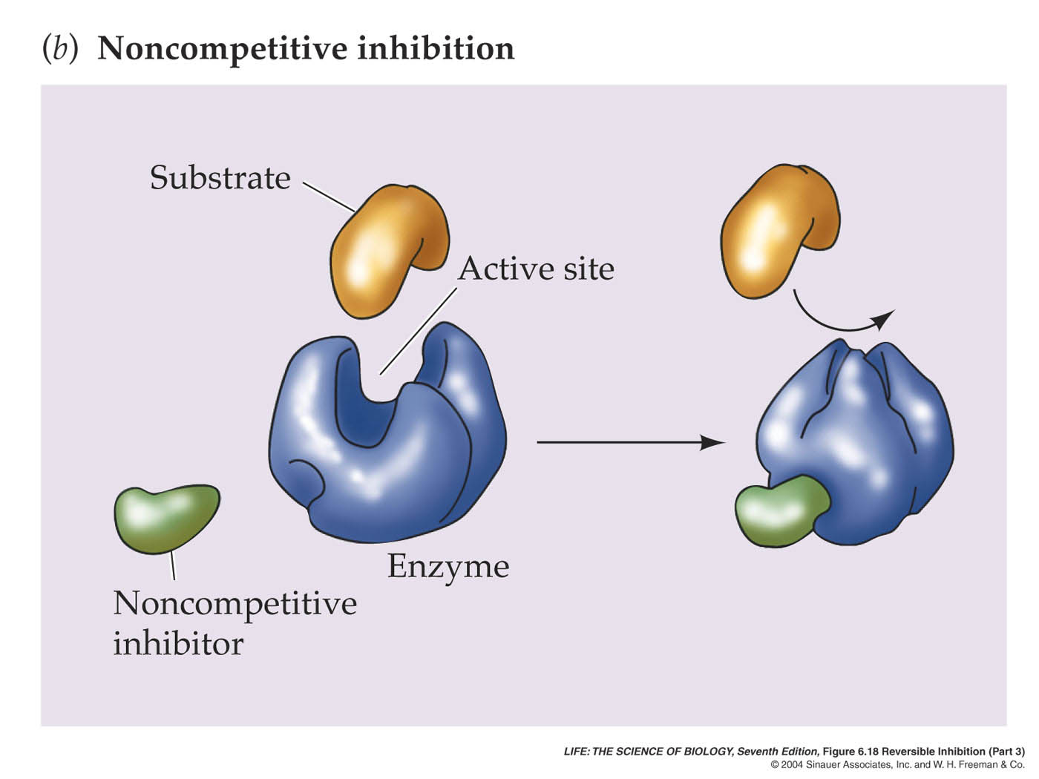
Figure 6.18 (b) Reversible Inhibition (Part 1)

Slide 55
Metabolism and the Regulation of Enzymes
The change in enzyme shape due to noncompetitive inhibitor binding is an example of allostery.
Allosteric enzymes are controlled by allosteric regulators.
Allosteric regulators bind to an allosteric site, which is separate from the active site, and this changes the structure and function of the enzyme.
Allosteric regulators work in two ways:
Positive regulators stabilize the active form.
Negative regulators stabilize the inactive form.

Slide 56
Metabolism and the Regulation of Enzymes
Metabolic pathways typically involve a starting material, intermediates, and an end product.
The first step in the pathway is called the start up or commitment step.
Once this step occurs, other enzyme-catalyzed reactions follow until the product of the series builds up.
One way to control the whole pathway is to have the end product inhibit the first step in the pathway.
This is called end-product inhibition or feedback inhibition.

Slide 57
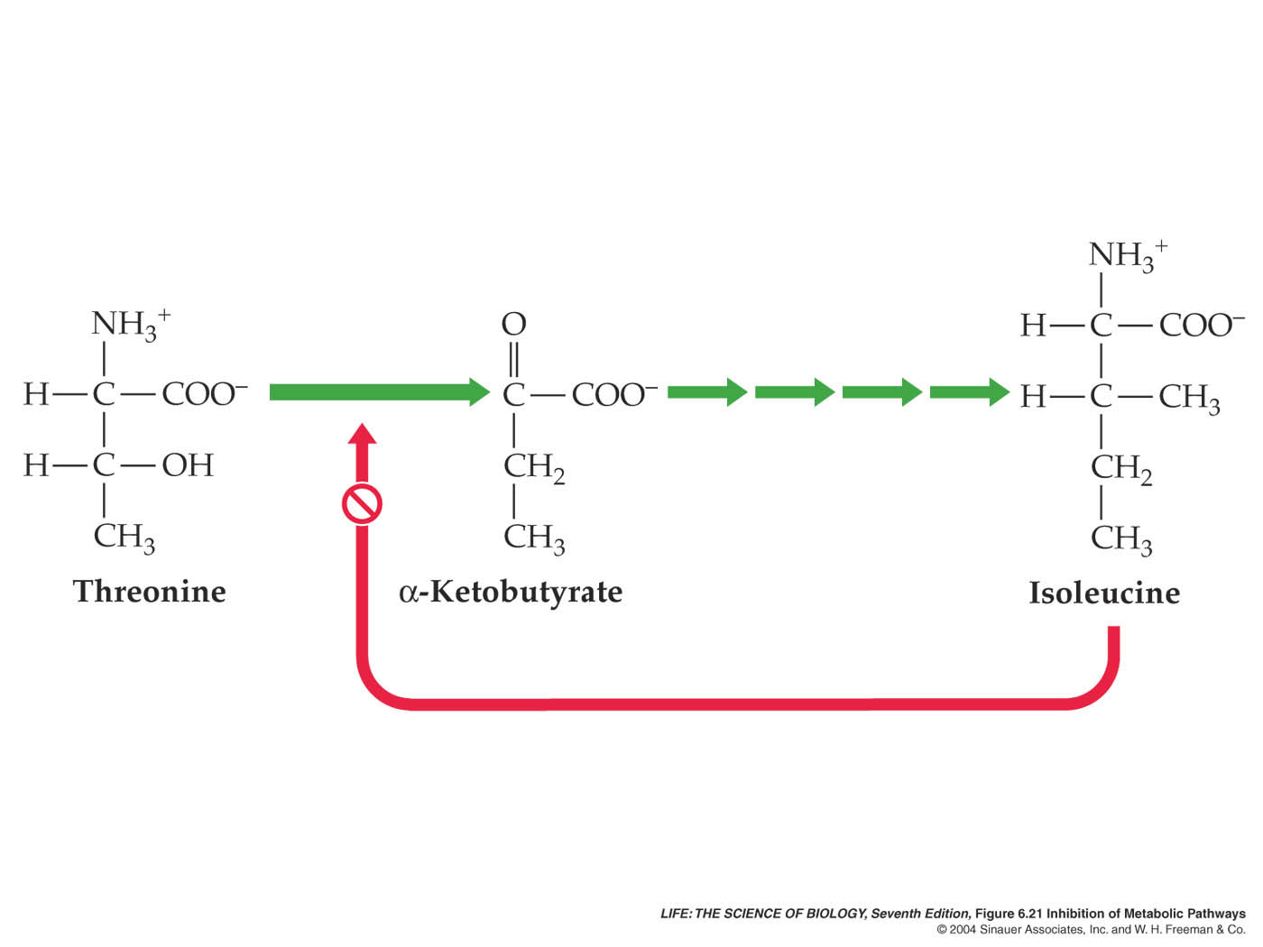
Figure 6.21 Inhibition of Metabolic Pathways

Slide 58
Metabolism and the Regulation of Enzymes
Rates of most enzyme-catalyzed reaction depend on the pH of the medium.
Each enzyme is most active at a particular pH.
pH can change the charges of the carboxyl and amino groups of amino acids. This affects the interactions of the amino acids and can change the structure of the protein.

Slide 59
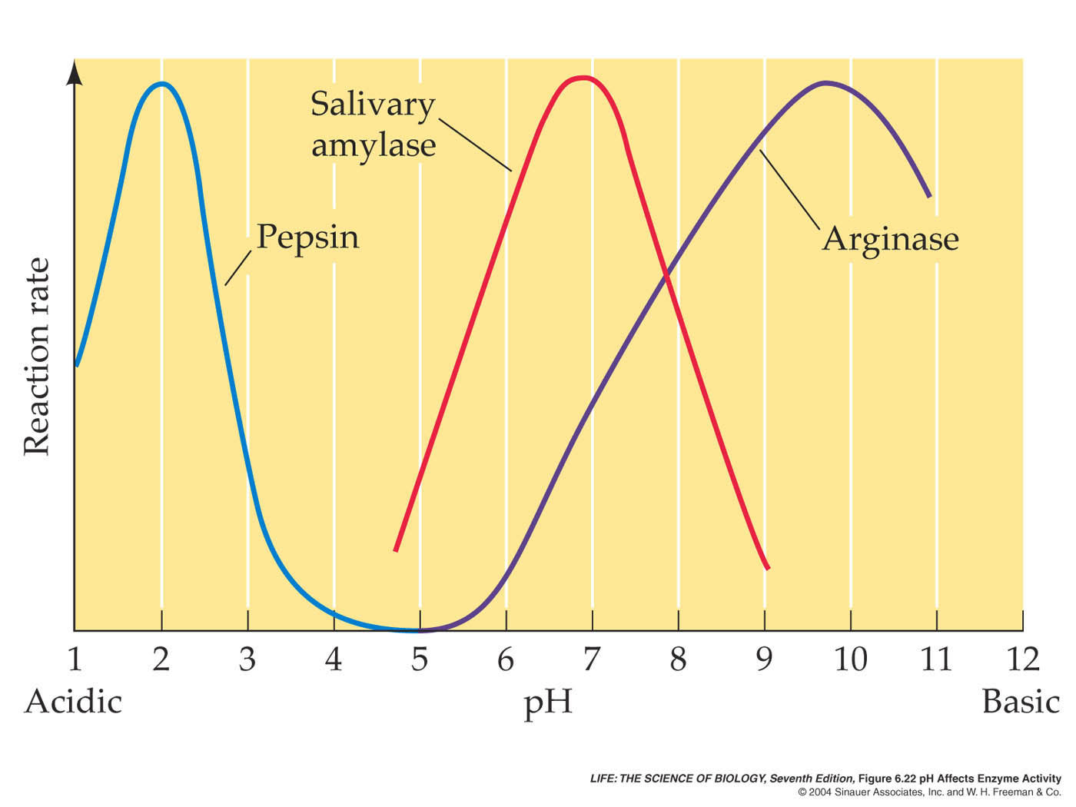
Figure 6.22 pH Affects Enzyme Activity

Slide 60
Metabolism and the Regulation of Enzymes
Temperature also affects enzyme activity.
High temperature can inactivate enzymes by breaking non-covalent bonds.
If the tertiary structure is disrupted the enzyme is called denatured.
Some organisms that can live at different temperatures generate different forms of an enzyme, called isozymes.
Enzymes adapted to warm temperatures usually have a tertiary structure of covalent bonds, such as disulfide bridges.

Slide 61
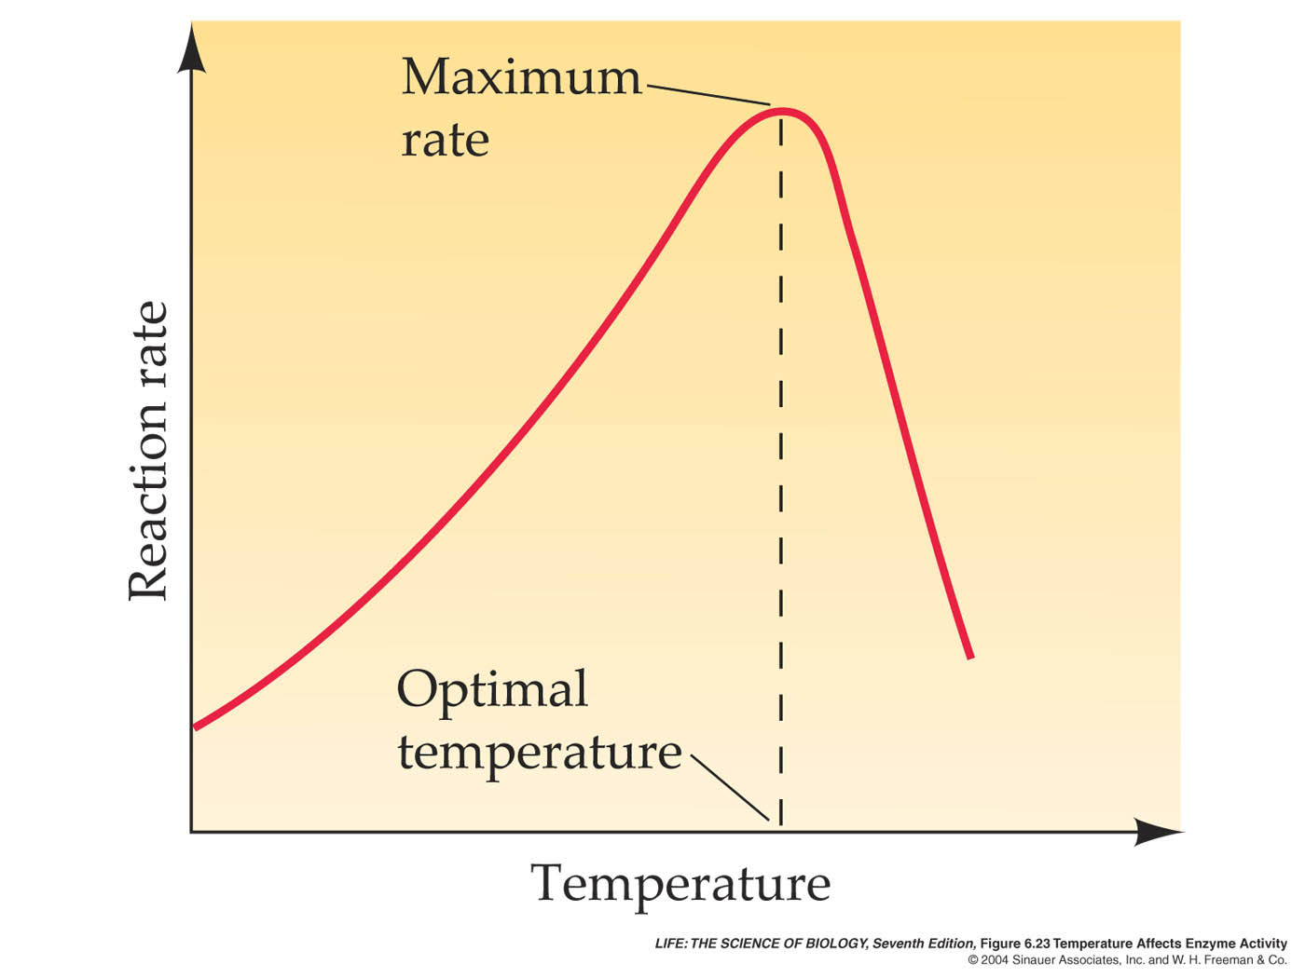
Figure 6.23 Temperature Affects Enzyme Activity

